Slide 1
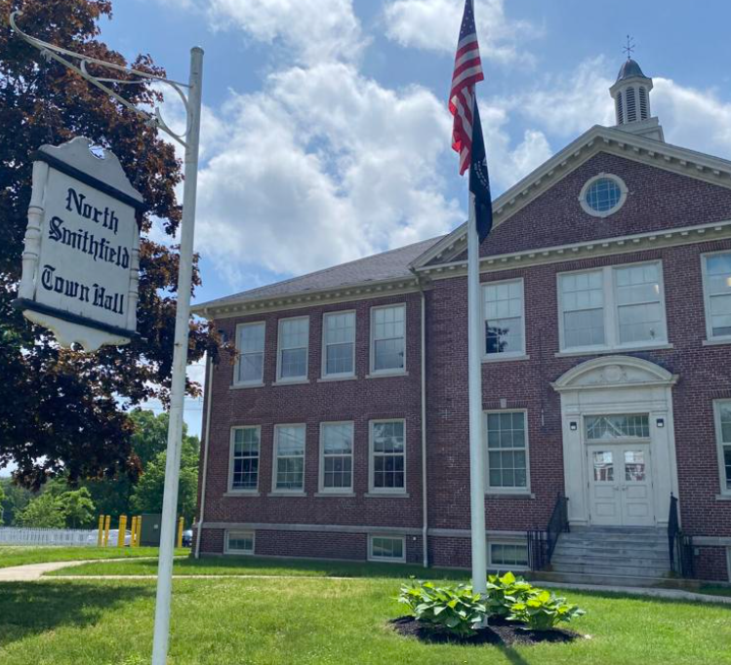

Proposal for a Townwide Asset Management Program
Optimizing the Life of Town Assets for Sustained Operations

Slide 2


Introduction
The goal of this presentation is to provide information to the Town Council on the need to develop an Asset Management Plan that will define the long-term strategy and steps necessary to properly and effectively manage town assets over time.
Current Commission members:
Paul Nordstrom, Chairman
Joshua Wowk
Louis Maccarone, Vice Chairman
Roark Maynard, Secretary
Vacant

Slide 3

What is Asset Management (AM)?
A sustainable plan that ensures identified assets can be kept healthy and working properly with appropriate maintenance and repairs, while allowing the Town accuracy and predictability in budgeting for maintenance and, ultimately, replacement.

Slide 4
What is needed for an effective Asset Management Plan?
Development of a list and breakdown of assets
A condition assessment of those assets the town wants to track
A criticality/risk assessment analysis
Identification of best practices and effective management strategies
Development of a computerized maintenance management system to track assets

Slide 5
Asset Management Plans come in all sizes and levels of sophistication
Narragansett Bay Commission
North Smithfield School Department
North Smithfield Pump Station Asset Management Plan
Town of North Smithfield Road Improvement Program

Slide 6
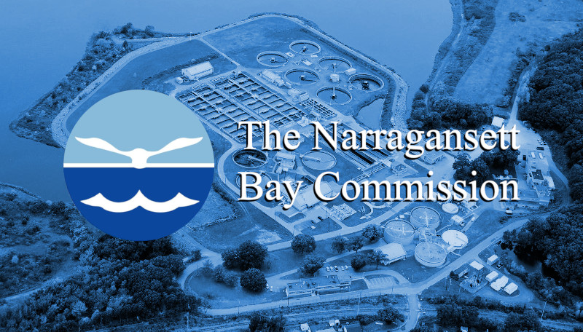
Narragansett Bay Commission AMP
Took about five years to develop and implement
A large inventory of assets:
    Forty buildings (and growing)
    Hundreds of miles of large diameter sewers
    Eight (and growing) pump stations
    Tens of thousand pieces of equipment
A computerized maintenance management system and Capital Improvement Program already in place
Through implementation, NBC was able to stabilize the annual expenditures by developing a long term (15 year)
Program has been in place for about fifteen years and is an integral part of the annual budget document (FY 19 Annual Budget $91,455,533)
https://www.narrabay.com/about/financial-information/

Slide 7

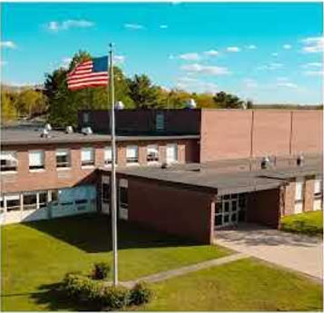
North Smithfield School Department
Condition Assessments, Jacobs 2017
Three buildings – High School, Middle School and NSES
Building systems evaluated – site, exterior envelope, interior finishes, plumbing, fire suppression, HVAC, electrical and lighting, security (communication and tele/Data), fire alarm and life safety systems, code compliance and accessibility.
SMMA on behalf of the NS School Dept edited and included results in Master Plan for RIDE submittal

Slide 8
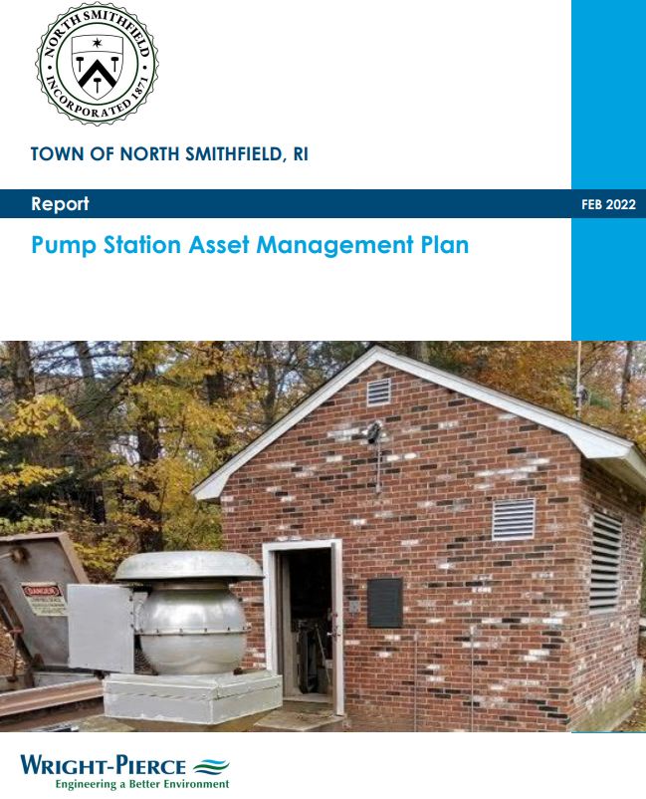
North Smithfield Pump Station AMP
Wright-Pierce 2022
Created an asset hierarchy for the nine pump stations and two metering stations
Conducted a condition assessment of each
Performed a criticality/risk analysis
Identified best practices and management strategies for implementing an Assert Management Plan
Developed a five-year CIP
Provided evaluation findings in a format that the town can use to populate a Computerized Maintenance Management System in the future

Slide 9
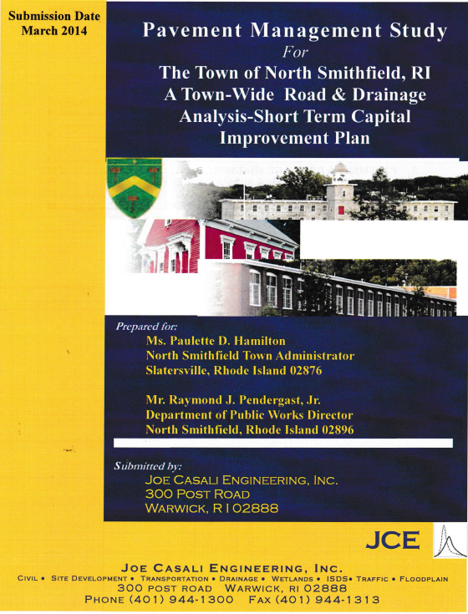
North Smithfield Road Management Program
Joe Casali Engineering, March 2014
Developed Roadway Inventory
Incorporated Inventory list into town GIS
Developed Roadway Condition Report (based on rating system)
Led to bond issue and annual repair/replacement program

Slide 10

Initial Work by Asset Management Commission
Reviewed the following documents:
  Audited Fixed Asset Listing (primary document)
  List of town insured properties from Interlocal Trust document
  Vehicle lists/logs from DPW and Police Department
  Capital Improvement Program

Slide 11
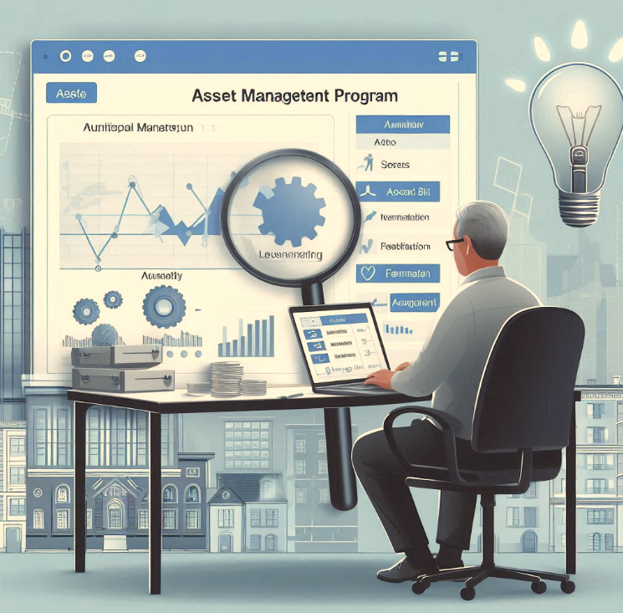
Early Decisions
Only look at assets greater than $5000
Useful life greater than three (3) years
Concentrate on vehicles and equipment initially
Goal of projecting repair/replacement of assets out fifteen (15) years
Hold off on entities that have some degree asset management
  DPW Roads
  School Department
  Enterprise fund entities (water and sewer)

Slide 12

Initial Findings (Vehicles and Equipment)
Inconsistencies between the three lists
Very little information about vehicles in asset register
  Missing VIN
  Wrong year/make/model
  No evidence there was a town-wide system to track all department vehicles and equipment (except police department and DPW)
Capital Asset Register is not set up for Asset Management

Slide 13

Differences between and Asset Listing for AMP vs Town of North Smithfield Asset Register
Audited Asset Register depreciates while AMP projects replacement value
Audited Asset Register not set up to provide details when an asset is established
Audited Asset Register lists bond projects by total cost (no breakdown of components or potential assets)
Lots of gaps in information needed for an AMP

Slide 14

Next Steps/Recommendations
Consider designating/creating a position that be an advocate for ensuring the program is followed by all affected departments (program will need constant updating/coordination). Until then, through RFQ process, find a firm/person to temporarily fill this need.
Hire a firm that specializes in developing municipal asset management programs.

Slide 15

Stumbling blocks that can undermine the program
Underfunding the program on an annual basis (restricted account)
Lack of commitment and/or buy-in
Failure to recognize it is an on-going program that
needs constant updating
Failure to stick to established guidelines
Turnover
Failure to recognize that you must spend money on asset replacement/repair to maintain the town’s assets

Slide 16
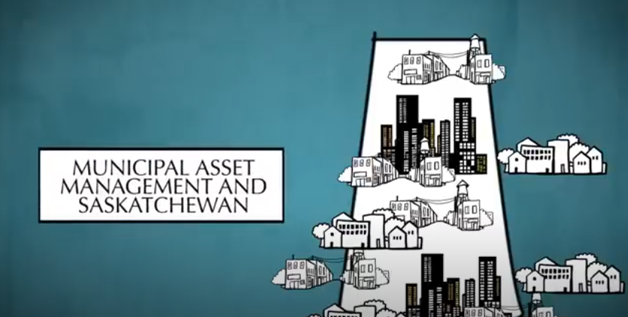
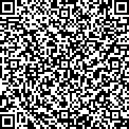
Real World Example
The link below is a short video (14 mins) of an example of one Municipality's journey implementing an Asset Management Plan.
Example of Asset Management in a Municipality
← ”Ctrl+Click” to follow link
DRAFT

Slide 17

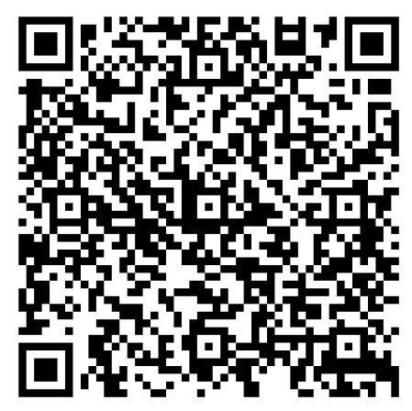
Implementing an Asset Management Plan
https://sarm.ca/wp-content/uploads/2022/03/asset-management-getting-started-guide-2013.pdf

Slide 18
Suggested Draft Scope of work for Development of an AM Plan
Phase I
Generate an asset listing/hierarchy
Conduct condition assessment on identified asset
Review town organizational structure – recommend where program fits in
Recommend/suggest different levels of complexity
Present options for funding the program
Review and recommend at least three applicable Asse Management Software Programs
Submit findings so town can determine level of comfort and then negotiate Phase II
Phase II (Training/Implementation)
Implement and populate data into Asset Management software
Educate/train staff in use of the program
Develop an Asset Management Manual that can be adopted and used town-wide
Assist town staff in turning the Asset Management Plan into a sustainable Program
Incorporate the Asset Management Plan into other key town functions (budget, planning, capital improvement program and future bonding)

