Slide 1
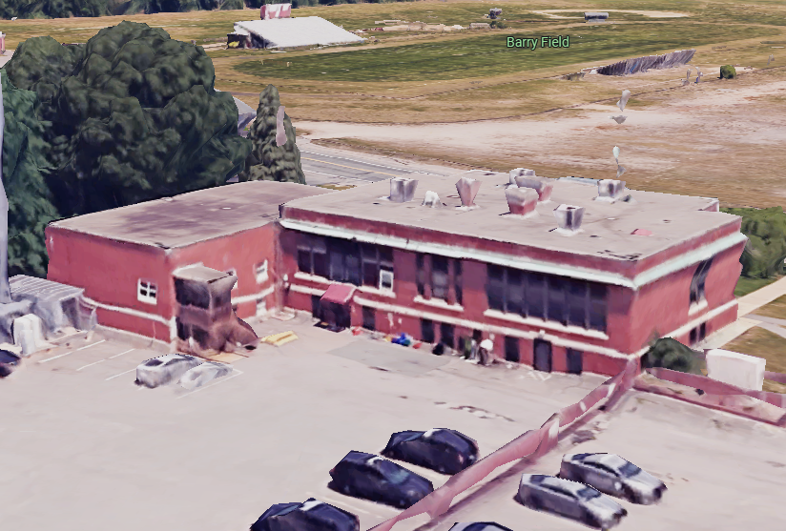

North Smithfield Public Safety Complex Project

Slide 2

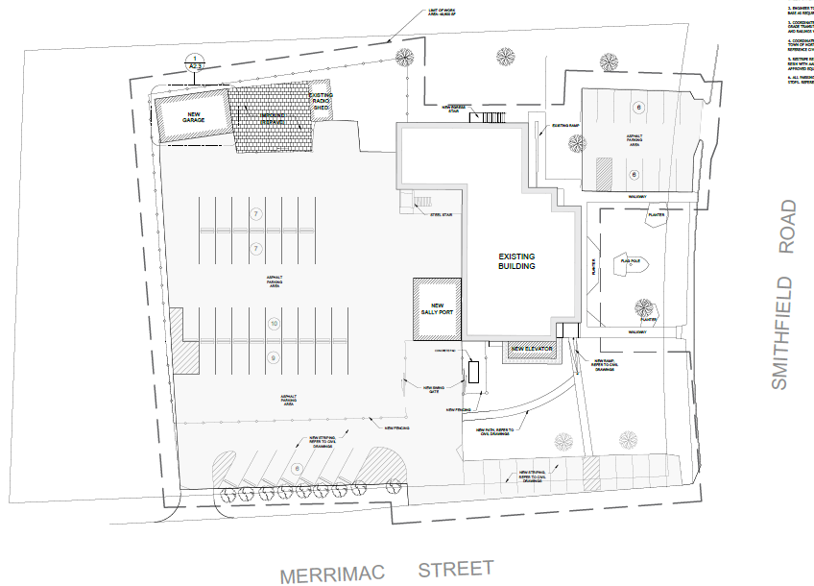

Proposed Site Plan
Add Alternate 3 New Garage
Add Alternate 1
New Sally Port
Add Alternate 4 Full Site Repairs
Add Alternate 2
New Elevator

Slide 3
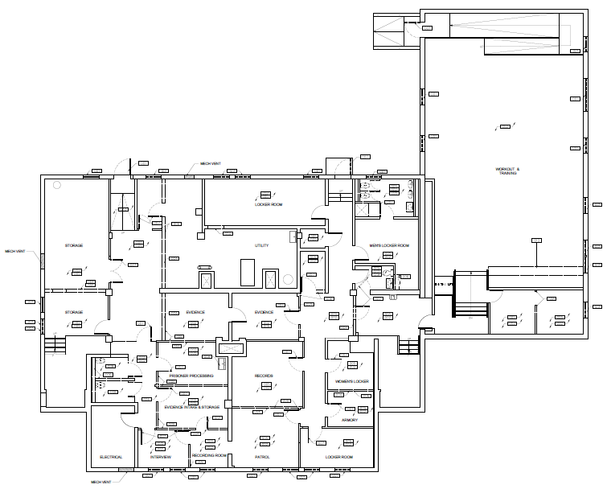
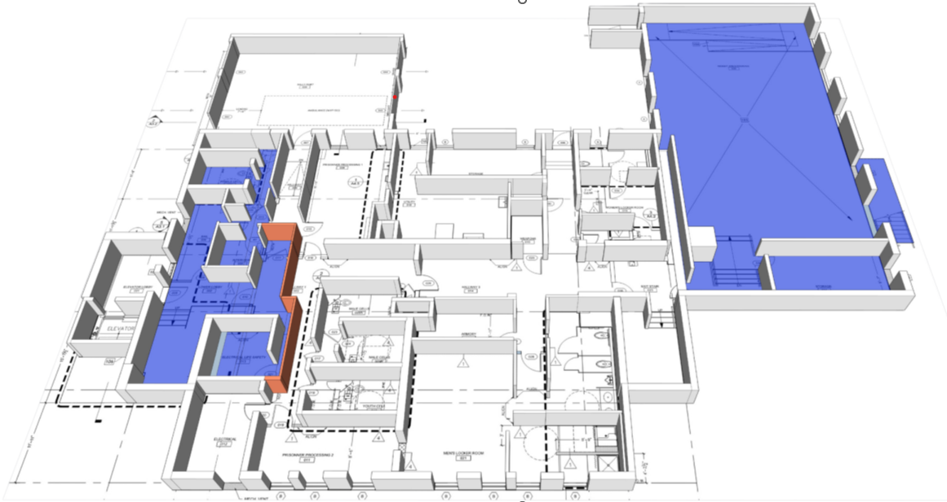
Lower Level
Existing Prisoner Intake
Proposed Plan
Add Alternate 1
New Sally Port
Existing Evidence & Records
Existing Plan
Add Alternate 2
New Elevator
New
Prisoner Intake

Slide 4
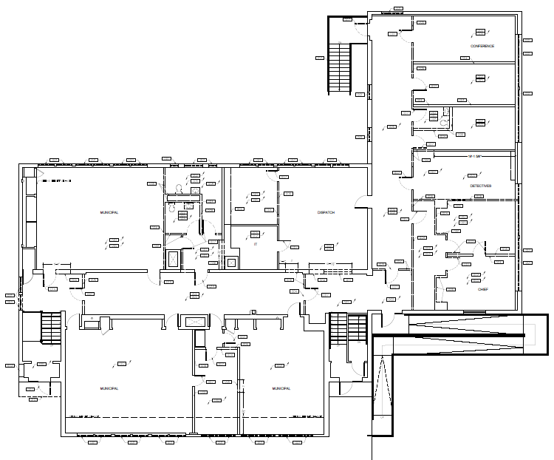
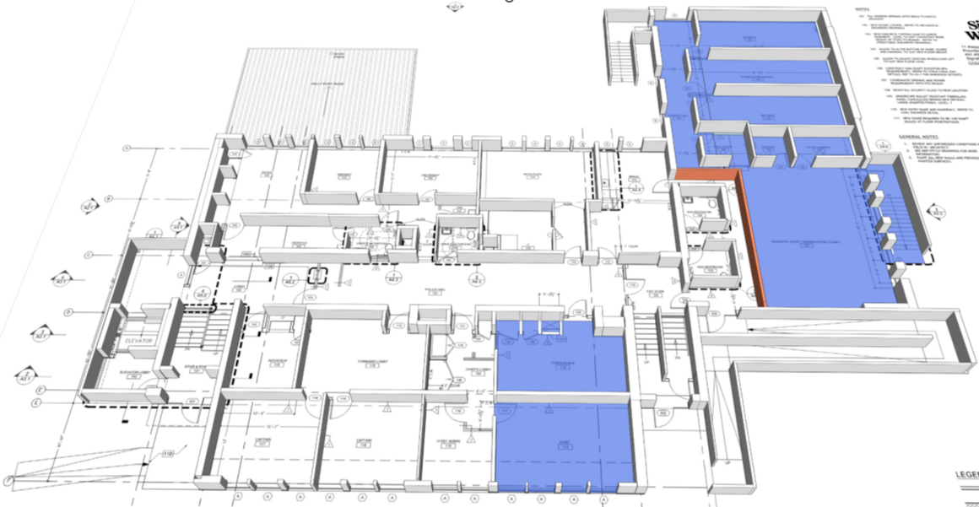
Upper Level
Existing
Un-Utilized Space
Existing
Police Dept.
Offices
Proposed
Evidence &
Records
Proposed Plan
Proposed
Dispatch Dept.
Existing
Dispatch Dept.
Existing Plan
Proposed
Police Dept.
Offices
Proposed
Municipal Court

