Slide 1
North Smithfield,
Rhode Island
Debt and Credit Analysis
November 10, 2025
PFM Financial Advisors LLC
100 High Street
Suite 2300
Boston, MA 02110
(617) 330.6914
pfm.com

Slide 2
Existing Debt Service

Slide 3
Existing Debt Service
The Town had $10,825,000 outstanding General Fund debt as of June 30, 2025
The Town’s existing debt has rapid amortization – 92% amortized during the next 10 years
Debt service declines starting in FY2027
Fiscal Year

Slide 4
Proposed New Debt Service

Slide 5
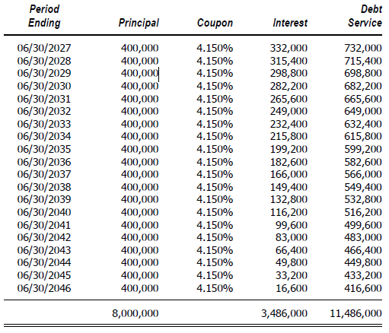
Proposed Bonds – Sample Debt Service
Bond Debt Service
20 Year Term
Dated February 15,2026

Slide 6
Existing and Proposed
New Debt Service

Slide 7
Existing and Proposed Debt Service

Slide 8
Credit Analysis

Slide 9
Moody’s Financial Ratio Analysis Comparison
MFRA as of FY2024
Population 10,000 to 50,000

Slide 10
7- Year Trend Analysis: Available Fund Balance and Debt Analysis
Fiscal Year
Fiscal Year
*Unassigned General Fund Balance as of June 30, 2024 was $9,936,914.

Slide 11
Disclosures
PFM is the marketing name for a group of affiliated companies providing a range of services. All services are provided through separate agreements with each company. This material is for general information purposes only and is not intended to provide specific advice or a specific recommendation. PFM does not provide tax, legal or accounting advice.
Financial advisory services are provided by PFM Financial Advisors LLC, a registered municipal advisor with the Securities and Exchange Commission (SEC) and the Municipal Securities Rulemaking Board (MSRB) under the Dodd-Frank Act of 2010.
Swap advisory services are provided by PFM Swap Advisors LLC which is registered as a municipal advisor with both the MSRB and SEC under the Dodd-Frank Act of 2010, and as a commodity trading advisor with the Commodity Futures Trading Commission. Additional applicable regulatory information is available upon request.
Consulting services are provided through PFM Group Consulting LLC. PFM’s financial modeling platform for strategic forecasting is provided through PFM Solutions LLC. A web-based platform for municipal bond information is provided through Munite LLC.
PFM Financial Advisors LLC clients, which may have been listed, were selected based on non-performance-based criteria to show a representation of clients. A full list is available upon request. The list of clients is for informational purposes only and does not constitute an endorsement or testimonial
For more information regarding PFM’s services or entities, please visit www.pfm.com.
Special disclaimer regarding the research and forecasts included in today’s presentation: This research and any forecasts are based on current public information, as of the date of this presentation (or as of such date as may be specified in the presentation), that we consider reliable, but we do not represent it as accurate or complete, and it should not be relied on as such. The information, opinions, estimates and forecasts contained herein are also as of the date hereof and are subject to change without prior notification.
Case studies are provided for information purposes only and do not constitute specific advice or a recommendation. Opinions, results, and data presented are not indicative of future performance. Actual results may vary. Inclusion on this list does not represent endorsement of PFM’s services.

